Slide 1
iGCSE History – Exam Advice
Paper 1
Knowledge and explanation

Slide 2
Question 1
4 marks
Based upon knowledge and description
4 accurate, detailed points
Revision is crucial
If you do not get 4 here, very difficult to reach the top grades
5 mins MAXIMUM

Slide 3
Question 2
6 marks
EXPLANATION IS KEY
Needs two or three points, explained in detail
USE PARAGRAPHS
Structure is very important
10-15 mins MAXIMUM
WHY ….
NOT JUST HOW
?

Slide 4
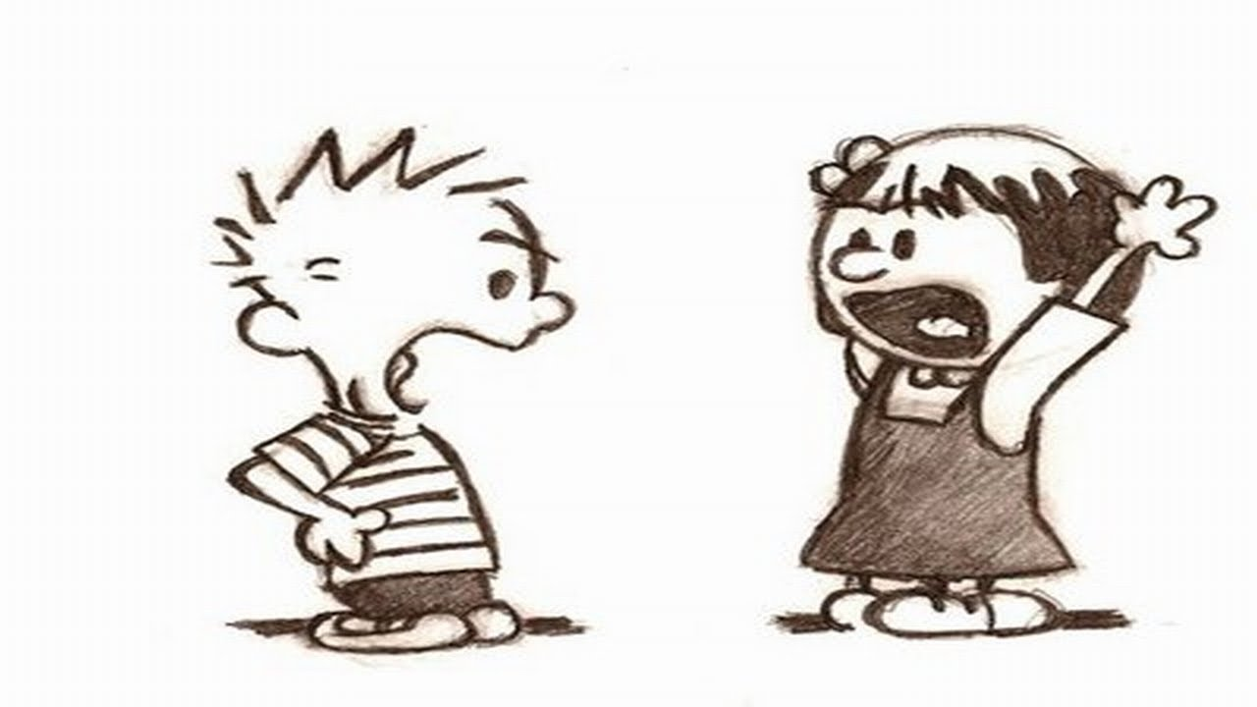
Question 3
10 marks – 20 minutes
A two sided argument
YOU MUST COVER BOTH SIDES
Stay focused on the question
3 Paragraphs
Argument /
Counter Argument /
Conclusion
Structure and Paragraphs are key!

