Slide 1
The Wars of Unification
1859 Italian War
1866 Austro-Prussian War
1870-71 Franco-Prussian War

Slide 2
1859 Italian War of Unification
Second Italian War of Independence/Austro-Sardinian War/Austro-Piedmontese War
French and Kingdom of Sardinia vs. Austrian Empire
French and Sardinians win – Sardinia takes Lombardy, France take Savoy and Nice
Leaders: Napoleon III, Victor Emmanuel II, Garibaldi, Cavour vs. Franz Josef I
Cavour (PM of Piedmont and Sardinia) pushed for unification after Crimean wars – gained support of French in return for giving them Nice and Savoy
Cavour provoked Austrians into starting war with Sardinia which drew the French in

Slide 3
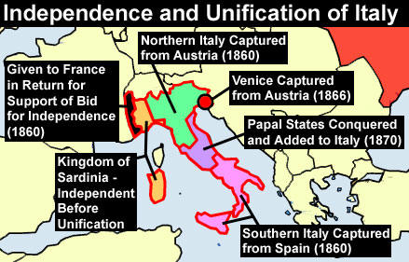

Slide 4
French had 170,000 soldiers, 2000 horsemen and 312 guns – led by Napoleon III, split into 5 corps
Sardinians had 70,000 soldiers, 4000 horsemen and 90 guns, split into 5 divisions
Austrians had 220,000 soldiers, 824 guns and 22,000 horsemen led by Count Gyulai

Slide 5
At start of war – no French in Italy so massive use of railways to bring in troops
Austrians planned to quickly defeat Sardinians before facing the French
However Gyulai was cautious and heavy rains meant the Piedmontese could flood rice fields and slow him down
First battle was at Montebello – Austrians vs. French division – Austrians 3 times as big but French were victorious – Gyulai became more cautious

Slide 6
Battle of Magenta
June 1859
Napoleon III’s army crossed Ticino River and outflanked Austrian right forcing them to retreat
Challenging geography – canals, streams, orchards prevented elaborate manoeuvre
Austrians turned houses into fortresses
French-Sardinian decisive victory – 1,100 Piedmontese and 58,000 French so mostly French

Slide 7
Battle of Solferino
138000 French and Sardinian vs. 129000 French
Gyulai was removed – Emperor Franz Josef took over as leader
Piedmontese-French took Milan and were heading East to beat Austria before Prussians joined in
French planned counter attack but armies essentially met by accident at Solferino – uncoordinated
Fought in three locations – Medole, Solferino and San Martino
French corps held off 3 Austrian corps at Medole – stopped them joining Solferino despite having smaller army – Niel skilled at counter attacks and defending
Solferino – French broke through after a day causing Austrian retreat
San Martino – Sardinians vs Austrians – Austrians under Benedek were inferior numerically but beat off Sardinians until whole Austrian army retired

Slide 8
End of War
French feared German involvement so signed armistice with Austria
Most of Lombardy went to France who gave this to Sardinia
Central states occupied by Piedmontese – meant to be resorted to original rulers but weren’t
1860 – Central Italian states officially annexed by Sardinia

Slide 9
Key aspects:
Alliances – Piedmont strongly aided by the French
Generals – Gyulai over cautious – slow to meet Sardinian’s giving French time to arrive
Technology – use of railways by French to rapidly deploy troops
Planning and tactics – French used railways to deploy and supply large armies. Used long range artillery to attack enemy while out of their reach. Frontal column assaults used by French. Mass casualties showed brutality of frontal assaults e.g. 80000 at Solferino
Quality of soldiers – French had good quality and used shock columns at Solferino against Austrians – very brave
Command and control – difficult with size of armies (275,000) and not well done – accidental battle at Solferino
Public opinion – French entered war due to public sympathy in France and attempt on Napoleon III’s life by an Italian nationalist

Slide 10
How much of a turning point were the Prussian Wars?

Slide 11
1866 Austro-Prussian War
German confederation under the Austrian Empire vs. Kingdom of Prussia and Italy
Led to Prussian dominance over German states and Italians annexed Venetia
Caused by increasing desire for dominance over central Europe by Austria and Prussia, as well as rise of German nationalism
Bismarck as chancellor of Prussia – intended for unification? Set up alliance with Italy and ensured neutrality of the other European powers

Slide 12
Military reforms
Roon and Moltke
Conscription
Prussia had reserve army equal to size of army actually deployed against Austria – so could have dealt with French if they had intervened
Massive training and drilling of troops for 3 year service – contrasted with Austrian army where conscripts were sent home after induction – so had to be trained from scratch on outbreak of war – PRUSSIANS had much better quality
Austrians had great heavy cavalry – but no longer decisive as technology advanced

Slide 13
Mobilisation and concentration
Prussian army locally based – had Korps HQ so reservists lived near their depots – mobilisation would be quick
Austrians stationed units far from recruitment areas to stop revolts – took weeks to get to units
Prussia had better railways – could concentrate troops more rapidly – 285,000 men over 5 railway lines and concentrated in 25 days, Austrians only had one railway line
Railways prioritised army use
Austrians were more central but Prussians could assemble much quicker – 3 armies to outflank Austrians

Slide 14
Armaments and tactics
Prussians – Dreyse needle gun – breech loading
Austrians adopted shock tactics – coming closer to the enemy despite the better weapons of the Prussians that were much more accurate
Austrians had superior artillery as it was breech loading rifled cannons, Prussians had muzzle loading, smooth bore – only just starting to see Krupp breech loading – but other Austrian shortcomings prevented artillery being decisive
Moltke used ‘mission tactics’ – avoided frontal assaults in favour of mobile skirmishing units

Slide 15
Economy
Prussian economy growing – could supply armies with breech loading rifles and later with Krupp artillery
Austrian economy struggling after Franco-Austrian war
But may not have been that different – so not a decisive factor as much as military reform and organisation
Railways and telegraph used
Moltke planned extensively – Prussian General Staff also key

Slide 16
Prussian General Staff
Career open to the talents
‘nervous system animating the lumbering body of the army’
Berthier and Imperial HQ?
Planning

Slide 17
Battle of Koniggratz
Bendek vs. Moltke
Austrian army of 240,000 faced Prussian Army of the Elbe 39,000 and First Army 85,000
Not that well planned?
Decisive battle where Prussians beat Austrians
Battlefield concentration, use of multiple units to trap and destroy enemy force between them
Benedek’s indecisiveness played a part, as did Prussian organisation, Dreyse rifles

Slide 18
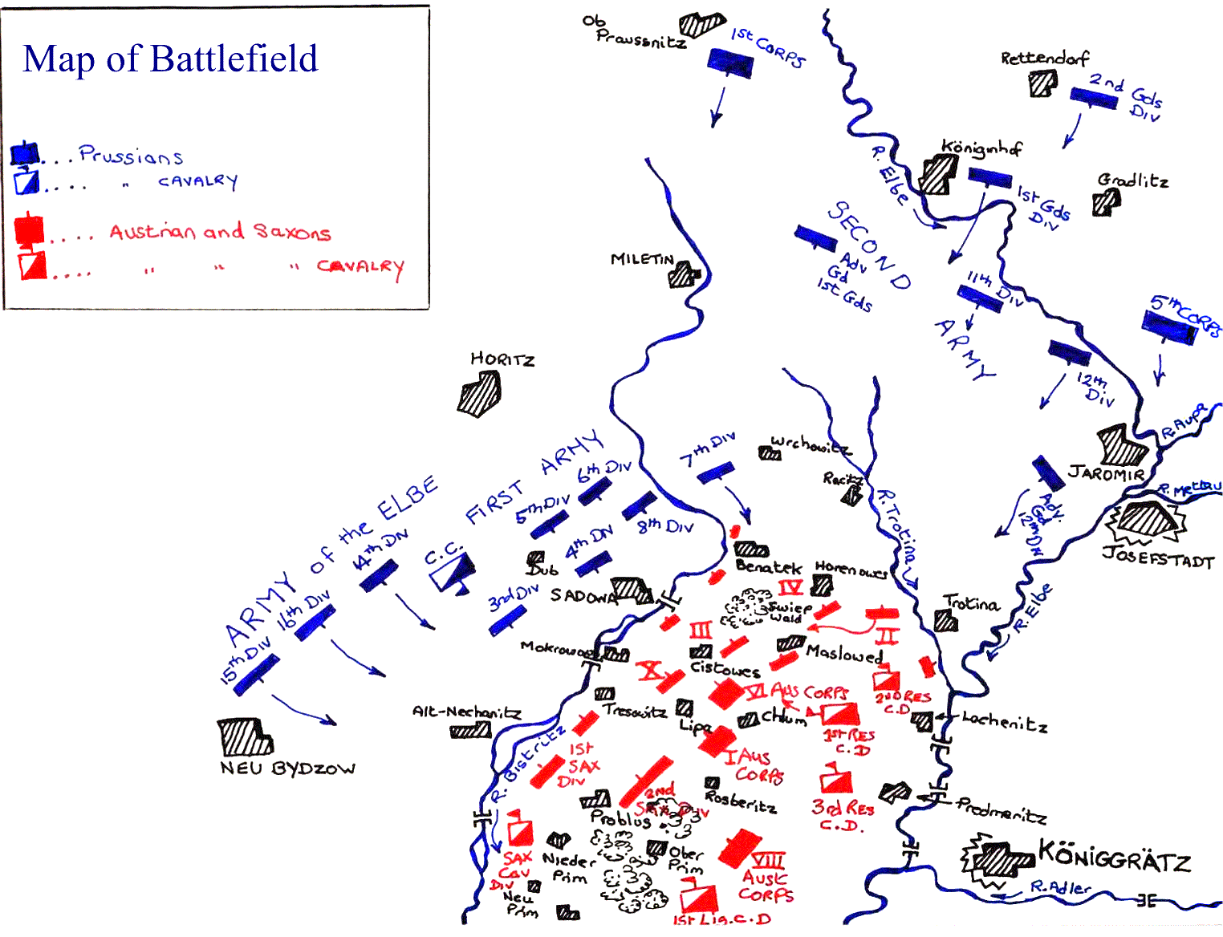

Slide 19
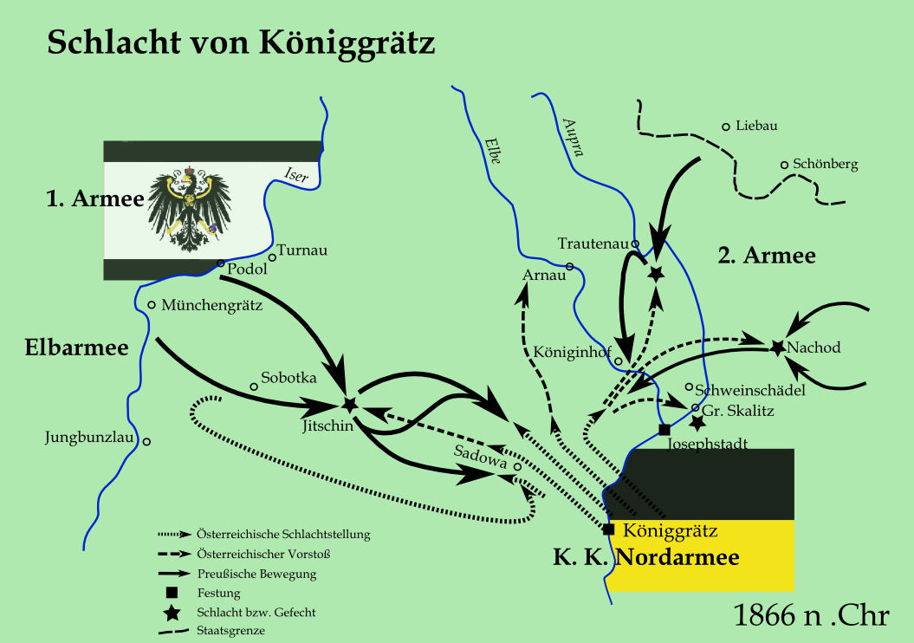

Slide 20
1870 Franco-Prussian War
French vs. Prussians and German states
French worried about balance of power in Europe
Prussians – quick mobilisation, better training, leadership and better use of technology
French had 400,000 soldiers, some conscripts, but estimated they could only field 288,000 so brought in universal conscription but couldn’t implement this before war broke out
French had the Chassepot rifle
Prussians conscripted and organised – 380,000 troops in 18 days

Slide 21
Key battles:
Gravelotte-St Privat - largest during war. Prussians had 188,332 vs. French 112,800. French dug trenches and concealed artillery. Prussians advanced and French opened fire – French had better rifles but Prussians had better artillery. Massive casualities, French retreated
Siege of Metz and Battle of Sedan – French besieged at Metz, then withdrew to Sedan – encircled by Prussians and Napoleon III ordered them to break out but they couldn’t – Napoleon surrendered and taken prisoner with army . Metz surrended after 2 months

Slide 22
Siege of Paris
Germans declared empire and were blockading Paris- French govt. asked for armies to march on Paris and attack from all directions at same time
Guerrilla attacks on Prussians
Bismarck wanted bombardment of the city
Moltke wanted to occupy but Bismarck won – artillery for 3 weeks
French outnumbered and defeated
Similarities to ACW – civilian involvement

Slide 23
Why Prussians won:
General Staff – could control large fronted war, independence of officers, merit based
Universal conscription – French population bigger but Germans mobilised more men
Quick mobilisation – close to depots, use of railways controlled by General Staff
Diplomatic isolation for the French
Weapons – chassepot better than dreyse but French weren’t trained to use it properly. Prussians had better Krupp artillery – range and accuracy

Slide 24
Wars of Unification
Important for:
Developments in command and control (General Staff)
Use of new weaponry (artillery, breech loading rifles)
Developments in planning and preparation
Industrialisation

Slide 25
Do the Prussian reforms represent a turning point in the conduct of war?
Or are they a part of the continuing evolution of Napoleonic warfare?

Slide 26
Technology or army reforms as the decisive factor in the Prussian Wars?

Slide 27
Moltke – better than Napoleon?

Slide 28
Southern leaders, strategies and aims – 4 (page 58-62)
Northern leaders, strategies and aims – 4 (page 58-64)
Organisation of north and south - 4 (page 64-66)
Tactics including Sherman’s march to the sea - 4 (page 66-69)

