Slide 1
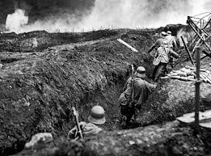
Britain Post WW1
Vast crowds gathered in London's Trafalgar Square to celebrate the victorious end of the First World War on 11 November 1918. However, various political, economic and social problems ensured that the return to peacetime conditions was not a soft landing.

Slide 2
The Devastating Cost of Conflict
Depression- unemployment was rife and inflation dramatically increased the cost of living
Loss of Life- the number of war dead was about 9.4 million- roughly 6,000 deaths every day of the war
Displaced People- The First World War also created a series of refugee crises, as the conflict forced whole populations - Armenians, Belgians, and Jews in Russia's Polish provinces - to flee from their homes to safer areas.

Slide 3
The Economy
During the First World War, Britain incurred debts equivalent to 136% of its gross national product
Unemployment in 1921 reached its highest point since records had begun

Slide 4
The Treaty of Versailles
Germany had to accept the Blame for starting the war
2. Germany had to pay £6,600 million (called Reparations) for the damage done during the war.
3. Germany was forbidden to have submarines or an air force. She could have a navy of only six battleships, and an Army of just 100,000 men. In addition, Germany was not allowed to place any troops in the Rhineland, the strip of land, 50 miles wide, next to France.
4. Germany lost Territory (land) in Europe & Germany’s colonies were given to Britain and France.

Slide 5
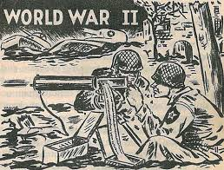
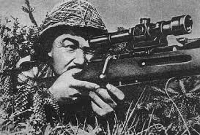
Britain Post WW2
There was a great instability in Europe after the first world war, so this set stage for the second. Afterwards Britain was again devastated and trying to recover from the damage.

Slide 6
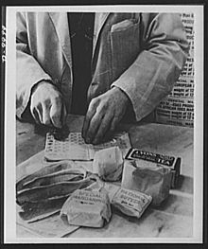
Rationing
Rationing in the UK began during the world war and continued until 1950
Rationing was introduced to deal with extreme food shortages
Each person had to register at a chosen shop and use coupons to receive their ration

Slide 7
Rationing in 1984
Rationing is still occurring in 1984 to Winston’s dismay; “the chocolate ration was reduced from thirty grammes to twenty”

Slide 8
2 minutes hate
Two Minutes Hate is a daily period in which Party members of the society of Oceania must watch a film depicting the Party's enemies (notably Emmanuel Goldstein and his followers) and express their hatred for them.
Orwell did not invent the idea behind the term "two minutes hate"; it was already in use in the First World War. At that time, British writers satirized the German campaign of hatred against the English, and imagined a Prussian family sitting around the kitchen table having its "morning hate“
Since 1919, on the second Sunday of November, otherwise known as Remembrance Sunday, a two minute silence has been observed at 11am at war memorials, religious services and shopping centers throughout the country.

Slide 9
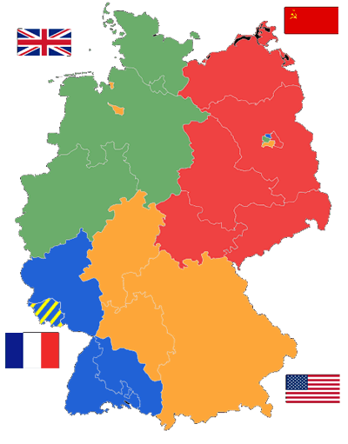
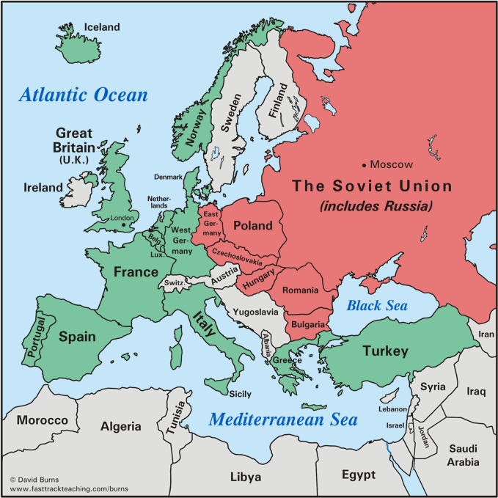
Division
Europe divided into 2 camps, nations that are allied with America in green, nations allied with Russia in red
German occupation zones after World War II

Slide 10
Division in 1984
“Eurasia comprises the whole of the northern part of the European and Asiatic landmass, from Portugal to the Bering Strait. Oceania comprises the Americas, the Atlantic islands including the British Isles, Australasia and the Southern portion of Africa. Eastasia, smaller than the others and with a less definite western frontier, comprises China and the countries to the south of it, the Japanese islands and a large but fluctuating portion of Manchuria, Mongolia and Tibet”

Slide 11
http://www.nationalarchives.gov.uk/pathways/firstworldwar/aftermath/brit_after_war.htm
http://www.historylearningsite.co.uk/treaty_of_versailles.htm
http://prezi.com/nufb5xi9wz77/1984-and-wwii/

