Slide 1
World Politics: 1910-1950 Eugenics and IVF Treatment
“One egg, one embryo, one adult – normality”

Slide 2
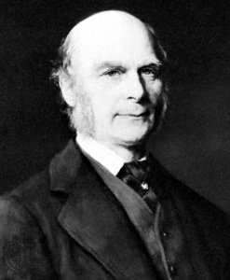
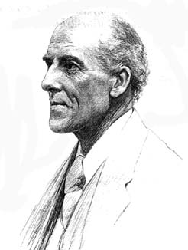
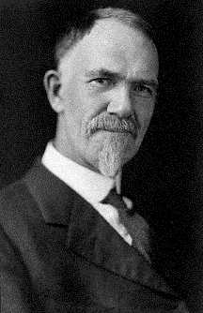
The History of Eugenics
Galton Pearson Davenport
The pioneers of Eugenics
Notes:
Dalton > Pearson > Davenport

Slide 3
Eugenics: A background
Galton Pearson Davenport
US and sterilization laws
Global affects
Galton background
Development [from Darwinian ideas]
Start and end

Slide 4
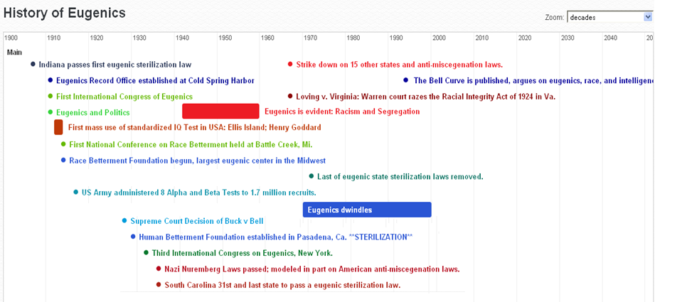
Eugenics: A timeline

Slide 5
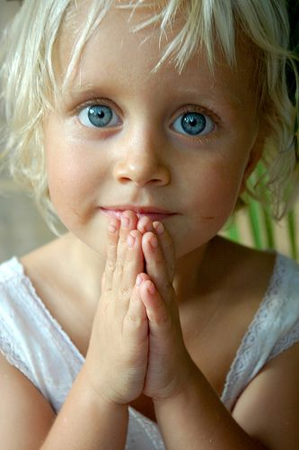
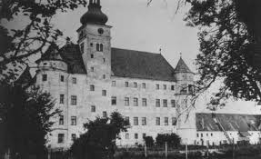
Eugenics and its links with Nazi Germany
“life unworthy of life”

Slide 6
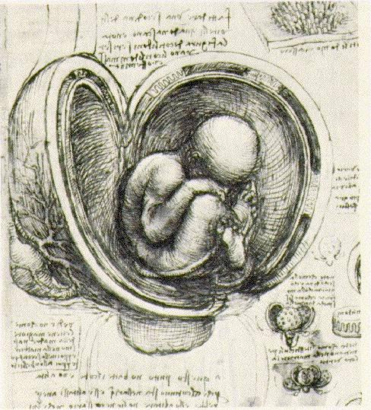
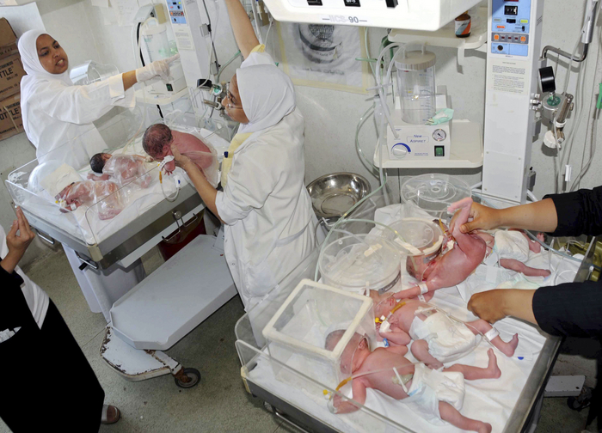
Eugenics & Brave New World

Slide 7
Eugenics & Brave New World
Positive Eugenics,
IVF – Chapter 1 ‘a brief description of the modern fertilizing process…’
“how the eggs which it contained were inspected for abnormalities…”
Cloning “A Bokanovskified egg will bud, will proliferate, will divide… every bud will grow into a perfectly formed embryo, and every embryo into a full sized adult. Making ninety-six human beings grow where only one grew before. Progress.”
… “If we could bokanovskify indefinitely the whole problem would be solved.”
“Eight minutes of hard X-rays being about as much as an egg can stand. A few died; of the rest, the least susceptible divided…”
echoes Darwin’s words
“Man, like every other animal, has no doubt advanced to his present high condition through a struggle for existence consequent on his rapid multiplication.”
Freemartins. Sterilization. “…we allow as many as thirty per cent of the female embryos to develop normally. The others get a dose of male sex hormone…”
Malthusian Drill. Linda’s death is an example of Euthanasia Jon could not adapt = suicide
Notes:
Eugenics and Brave New World - notes
IVF – Chapter 1 ‘a brief description of the modern fertilizing process…’ gives a detailed description of IVF which is very similar to the real process conducted today.
An example of Positive Eugenics, where reproduction of the desired traits are encouraged. In BNW it is done through IVF and IV pregnancy
‘the operation undergone voluntarily for the good of Society, not to mention… a bonus amounting to six months’ salary’ referring to a woman having some of her eggs removed for IVF.
“how the eggs which it contained were inspected for abnormalities…” Presumably only the normal eggs would be selected and abnormal ones destroyed. Thus only the eggs which have the desired traits, as decided by society, are allowed to survive. Similar to screening unborn babies for signs of downs syndrome or spinal bifida. Many of whom, upon discovery, are then aborted.
“A Bokanovskified egg will bud, will proliferate, will divide… every bud will grow into a perfectly formed embryo, and every embryo into a full sized adult. Making ninety-six human beings grow where only one grew before. Progress.” Cloning must be one of the most efficient examples of positive eugenics. If you have gone to all the trouble of painstakingly creating a ‘perfect’ embryo, you might as well make as many copies of it as you can rather than undergoing the whole selective process all over again. “If we could bokanovskify indefinitely the whole problem would be solved.”
The Bokanovsky process “Eight minutes of hard X-rays being about as much as an egg can stand. A few died; of the rest, the least susceptible divided…”
echoes Darwin’s words
“Man, like every other animal, has no doubt advanced to his present high condition through a struggle for existence consequent on his rapid multiplication.”
Freemartins. Sterilized women. “…we want to have a good choice. And of course one must always leave an enormous margin of safety. So we allow as many as thirty per cent of the female embryos to develop normally. The others get a dose of male sex-hormone every twenty-four metres for the rest of the course…”
Malthusian Drill.
Linda is allowed to lie in a hospital bed taking ever increasing amounts of soma until she dies. Euthanasia, a form of negative Eugenics where you allow imperfect people, who are a burden to society, to die. Linda was ugly, weak, addicted and viviparous, essentially useless to the brave new world society. But it is similar to our society. If we are all animals like Darwin seemed to think, why do we tolerate the existence of the Linda’s of our world? Maybe it is because they are hidden from us, living on the streets or in hospitals and care homes away from our middle class paradise.
When Jon starts to on his own in an abandoned building he creates a spectacle since it is so different to mainstream society. The attention he receives from journalists and the public, drives him to suicide. Perhaps, Huxley is satirising the survival of the fittest principle. Jon cannot adapt to mainstream society, so he dies and his discontent is not passed on.
Social predestination room. “We decant our babies as socialized human beings, as Alphas or Epsilons, as future sewage works or future… Directors of Hatcheries.” … “nothing like oxygen-shortage for keeping an embryo below par.”
Epsilons are compared to horses and cows. (Eugenic perspective on humans as animals) They are not valued for anything other than their ability to work. (links to the bell curve) “But though the Epsilon mind was mature at then, the Epsilon body was not fit to work until eighteen. Long years of superfluous and wasted immaturity. If the physical development could be speeded up till it was as quick, say as a cow’s, what an enormous saving to the Community!”
Brave New Worlders are able to stay young and useful to society until around age 60 or so when they suddenly just die. This has obviously been biologically engineered to be the case so that the maximum usefulness is exacted from these people. They are not burdens in their old age. (Links in with the bell curve model of human usefulness)
Savage reservation in BNW, similar to Native American Reservations. Also similar to the racial segregation in South Africa (justified by eugenic ideas), by the 1930s, had been firmly established through British and Dutch colonial rule., (although the official policy of ‘apartheid’ only came into being in 1948). People were also divided up into classes, similar to BNW: Whites/Alphas (who were the most ‘evolved’), Indians/Betas, Coloureds/Gammas, Blacks/ Epsilons
In BNW entertainment (Alphas have superior golf courses?), housing, occupations, education were all segregated by which class you were in. Similarly, in South Africa these factors were also decided by your ‘racial group’. Black people were not citizens of South Africa, they belonged to tribal ‘homelands’ known as bantustans not too dissimilar to BNW savage reservation. South Africans were also conditioned to hate ‘inferior races’ like in BNW.
1984 is an example of Negative Eugenics, where undesirable people are eliminated so they cannot pass on their genes or ideas. Perhaps the way in which people ‘disappear’ in 1984 is a form of cultural or political eugenics. In a way eugenic principals are applied to language as well, since newspeak is supposed to eliminate words which articulate thoughts that threaten Big Brother’s regime.

Slide 8
Eugenics & Brave New World
Social predestination room. “We decant our babies as socialized human beings, as Alphas or Epsilons, as future sewage works or future… Directors of Hatcheries.” … “nothing like oxygen-shortage for keeping an embryo below par.”
Human value determined by ‘usefulness’
“But though the Epsilon mind was mature at ten, the Epsilon body was not fit to work until eighteen. Long years of superfluous and wasted immaturity. If the physical development could be speeded up till it was as quick, say as a cow’s, what an enormous saving to the Community!”
The structure of people’s lives in BNW.
Savage reservations in BNW, similar to Native American Reservations and South African bantustans.
Racial segregation in South Africa and Brave New World
Whites/Alphas Indians/Betas Coloureds/Gammas Blacks/ Epsilons
1984 and Negative Eugenics,
Notes:
Eugenics and Brave New World - notes
IVF – Chapter 1 ‘a brief description of the modern fertilizing process…’ gives a detailed description of IVF which is very similar to the real process conducted today.
An example of Positive Eugenics, where reproduction of the desired traits are encouraged. In BNW it is done through IVF and IV pregnancy
‘the operation undergone voluntarily for the good of Society, not to mention… a bonus amounting to six months’ salary’ referring to a woman having some of her eggs removed for IVF.
“how the eggs which it contained were inspected for abnormalities…” Presumably only the normal eggs would be selected and abnormal ones destroyed. Thus only the eggs which have the desired traits, as decided by society, are allowed to survive. Similar to screening unborn babies for signs of downs syndrome or spinal bifida. Many of whom, upon discovery, are then aborted.
“A Bokanovskified egg will bud, will proliferate, will divide… every bud will grow into a perfectly formed embryo, and every embryo into a full sized adult. Making ninety-six human beings grow where only one grew before. Progress.” Cloning must be one of the most efficient examples of positive eugenics. If you have gone to all the trouble of painstakingly creating a ‘perfect’ embryo, you might as well make as many copies of it as you can rather than undergoing the whole selective process all over again. “If we could bokanovskify indefinitely the whole problem would be solved.”
The Bokanovsky process “Eight minutes of hard X-rays being about as much as an egg can stand. A few died; of the rest, the least susceptible divided…”
echoes Darwin’s words
“Man, like every other animal, has no doubt advanced to his present high condition through a struggle for existence consequent on his rapid multiplication.”
Freemartins. Sterilized women. “…we want to have a good choice. And of course one must always leave an enormous margin of safety. So we allow as many as thirty per cent of the female embryos to develop normally. The others get a dose of male sex-hormone every twenty-four metres for the rest of the course…”
Malthusian Drill.
Linda is allowed to lie in a hospital bed taking ever increasing amounts of soma until she dies. Euthanasia, a form of negative Eugenics where you allow imperfect people, who are a burden to society, to die. Linda was ugly, weak, addicted and viviparous, essentially useless to the brave new world society. But it is similar to our society. If we are all animals like Darwin seemed to think, why do we tolerate the existence of the Linda’s of our world? Maybe it is because they are hidden from us, living on the streets or in hospitals and care homes away from our middle class paradise.
When Jon starts to on his own in an abandoned building he creates a spectacle since it is so different to mainstream society. The attention he receives from journalists and the public, drives him to suicide. Perhaps, Huxley is satirising the survival of the fittest principle. Jon cannot adapt to mainstream society, so he dies and his discontent is not passed on.
Social predestination room. “We decant our babies as socialized human beings, as Alphas or Epsilons, as future sewage works or future… Directors of Hatcheries.” … “nothing like oxygen-shortage for keeping an embryo below par.”
Epsilons are compared to horses and cows. (Eugenic perspective on humans as animals) They are not valued for anything other than their ability to work. (links to the bell curve) “But though the Epsilon mind was mature at then, the Epsilon body was not fit to work until eighteen. Long years of superfluous and wasted immaturity. If the physical development could be speeded up till it was as quick, say as a cow’s, what an enormous saving to the Community!”
Brave New Worlders are able to stay young and useful to society until around age 60 or so when they suddenly just die. This has obviously been biologically engineered to be the case so that the maximum usefulness is exacted from these people. They are not burdens in their old age. (Links in with the bell curve model of human usefulness)
Savage reservation in BNW, similar to Native American Reservations. Also similar to the racial segregation in South Africa (justified by eugenic ideas), by the 1930s, had been firmly established through British and Dutch colonial rule., (although the official policy of ‘apartheid’ only came into being in 1948). People were also divided up into classes, similar to BNW: Whites/Alphas (who were the most ‘evolved’), Indians/Betas, Coloureds/Gammas, Blacks/ Epsilons
In BNW entertainment (Alphas have superior golf courses?), housing, occupations, education were all segregated by which class you were in. Similarly, in South Africa these factors were also decided by your ‘racial group’. Black people were not citizens of South Africa, they belonged to tribal ‘homelands’ known as bantustans not too dissimilar to BNW savage reservation. South Africans were also conditioned to hate ‘inferior races’ like in BNW.
1984 is an example of Negative Eugenics, where undesirable people are eliminated so they cannot pass on their genes or ideas. Perhaps the way in which people ‘disappear’ in 1984 is a form of cultural or political eugenics. In a way eugenic principals are applied to language as well, since newspeak is supposed to eliminate words which articulate thoughts that threaten Big Brother’s regime.

Slide 9
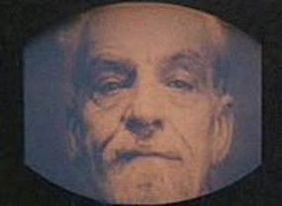
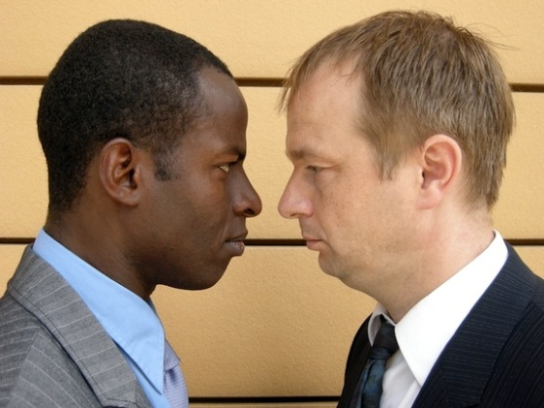
Eugenics – Link between texts and reality
Epsilons are stupid. Thank Ford I am a Gamma…
Social conditioning
1984
I hate them…
Nazi Propaganda
South Africa
Brave New World

Slide 10
Eugenics

