Slide 1
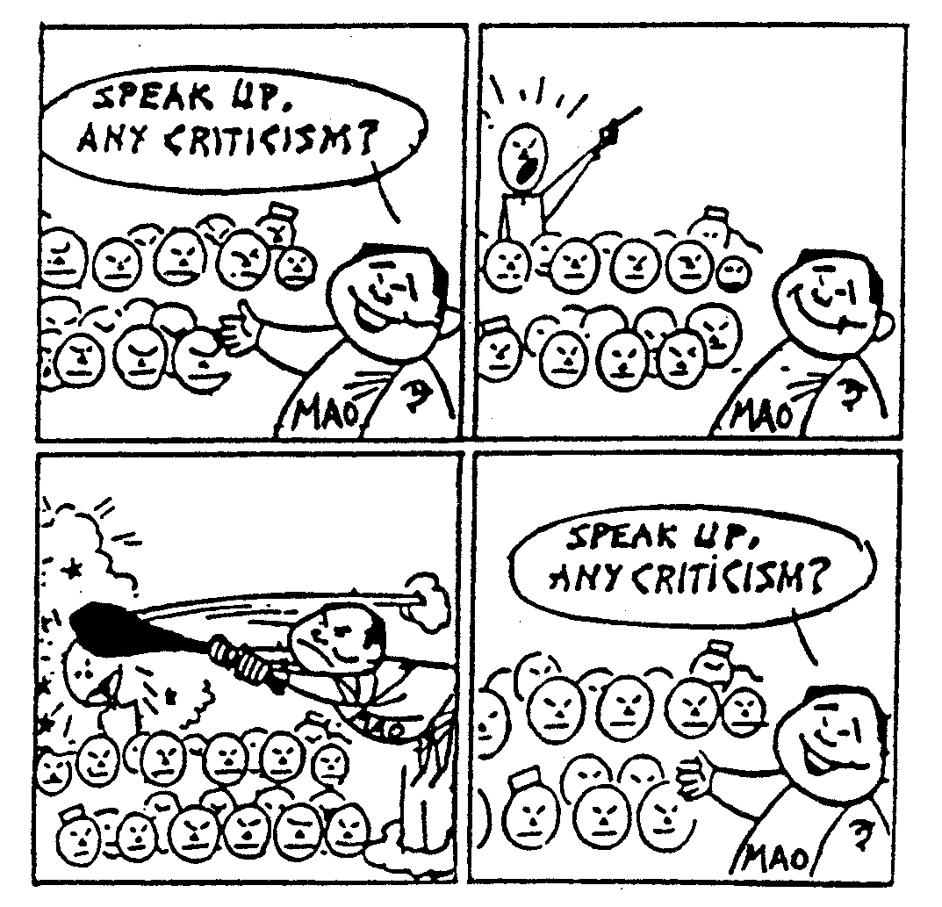
Why did the Hundred Flowers Campaign occur?

Slide 2
Why was Mao confident to allow criticism by 1957?
What problems were arising in China by 1957?
Who was targeted and why?
Who from this intellectual group escaped persecution and why?

Slide 3
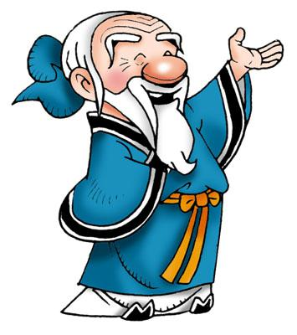
The ‘Hundred Flowers’ Campaign
‘Let a hundred flowers blossom, let a hundred schools of thought contend’
What does this mean?
An Ancient Chinese Philosopher – the expression comes from a traditional poem.

Slide 4
Letting a hundred flowers blossom and a hundred schools of thought contend is the policy for promoting progress in the arts and sciences and a flourishing socialist culture in our land. Different forms and styles in art should develop freely and different schools in science should contend freely. We think that it is harmful to the growth of art and science if administrative measures are used to impose one particular style of art or school of thought and to ban another. Questions of right and wrong in the arts and science should be settled through free discussion in artistic and scientific circles and through practical work in these fields.
People may ask, since Marxism is accepted as the guiding ideology by the majority of the people in our country, can it be criticized? Certainly it can. Marxism is scientific truth and fears no criticism. If it did, and if it could be overthrown by criticism, it would be worthless. Marxists should not be afraid of criticism from any quarter. Carrying out the policy of letting a hundred flowers blossom and a hundred schools of thought contend will not weaken, but strengthen, the leading position of Marxism in the ideological field….. Therefore, it is only by employing the method of discussion, criticism and reasoning that we can really foster correct ideas and overcome wrong ones, and that we can really settle issues.

Slide 5
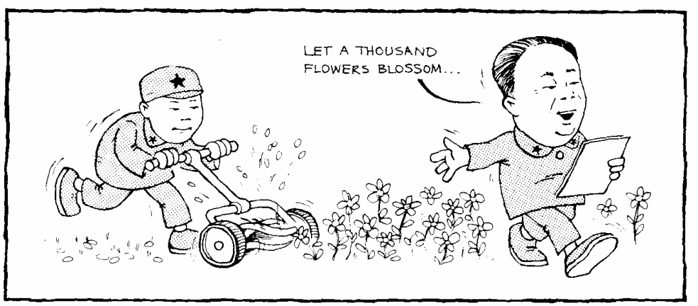

Slide 6
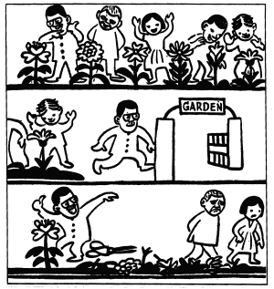
The people like many flowers. The old-fashioned Party man thinks they need only one…the one he likes.

Slide 7
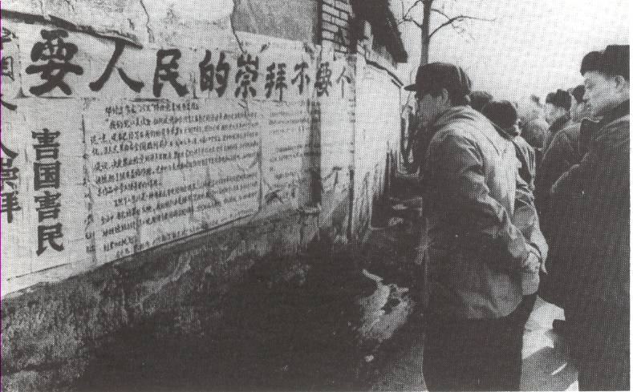
'Democracy Walls' . . .
Mao allowed critics to post their views at certain locations on walls or in small meeting rooms [known as ‘seminars’]. In this way their views could be easily controlled and not reach the masses – posters could be removed, meeting rooms only admitted small numbers.

Slide 8
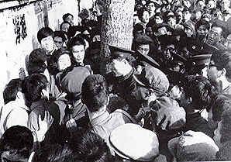
What did people protest about?
Totalitarian power is peril!
In not protecting citizens’ rights, today’s government is worse than the feudal dynasties or Chiang Kai-shek.
The Constitution is no more than toilet paper
I have indeed heard about peasants . . . Dying from having just grass roots to eat, in areas so rich in produce that they are known as the land of fish and rice. But the newspapers say nothing about any of this . . .
Why is it necessary to have “leadership” in the arts? Who led Shakespeare, Tolstoy, Beethoven, Moliere?’

Slide 9
‘In Yanan was Chairman Mao, who had two dishes plus soup for every meal, having a hard time? Were the peasants, who had nothing to eat but bitter vegetables, enjoying the good life? Everyone was told that Chairman Mao was leading a hard and simple life. That son of a bitch! A million shames on him! ... Our pens can never defeat Mao Zedong's Party guards and his imperial army. When he wants to kill you, he doesn't have to do it himself. He can mobilise your wife and children to denounce you and then kill you with their own hands! Is this a rational society? This is class struggle, Mao Zedong style!’
(Benton and Hunter p. 101).

Slide 10
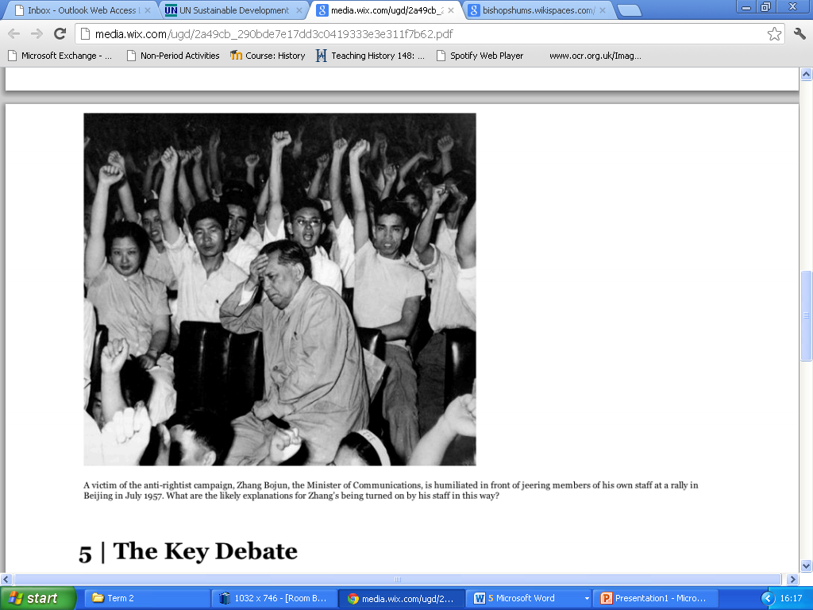
Once critics of Mao revealed themselves, Mao retaliated and isolated them. Many were subjected to ‘Struggle’ sessions, where they had to listen to many hours of accusations and, ultimately, apologise for their supposed past ‘faults’ or ‘crimes’.

Slide 11
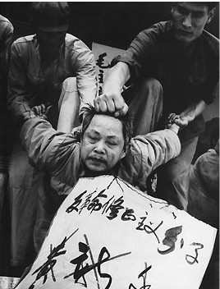
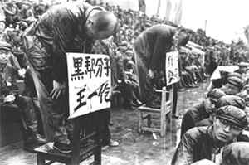
Struggle sessions

Slide 12
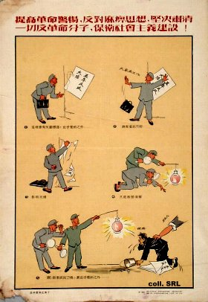
The Anti-Rightist Campaign
Mao’s attacks on intellectuals broadened into a general campaign of repression, known as the ‘Anti-Rightist’ campaign. Anybody who expressed even the slightest opposition to Mao stood the risk of being reported, victimised and forced to take part in ‘Struggle Sessions’.
Raise revolutionary violence, oppose slackers, resolutely eliminate all revolutionary

Slide 13
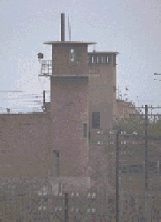
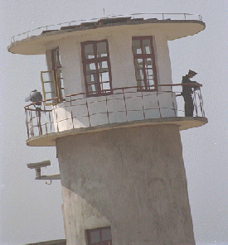
FORCED LABOUR CAMPS - THE LAOGAI
A view of Laiyang Heavy Machinery Plant

Slide 14
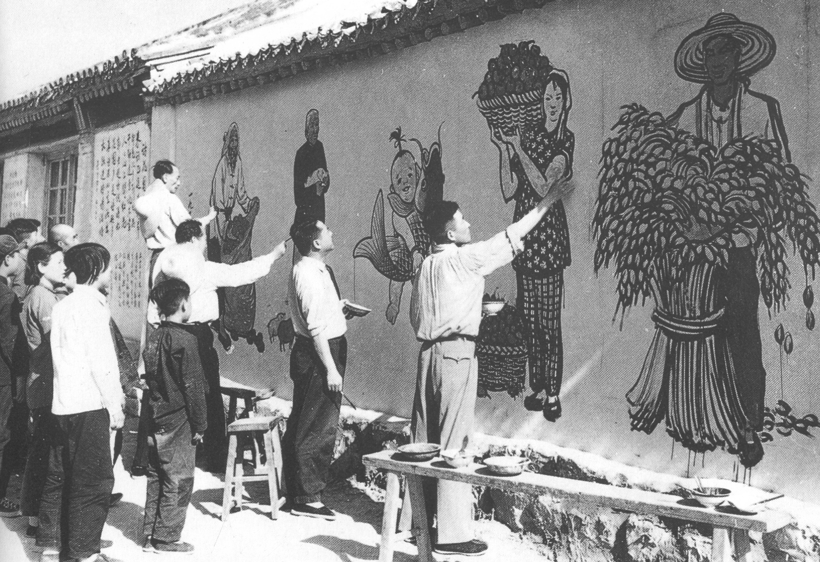
Artists, who had been sent to a forced labour camp, having to work on propaganda paintings on the side of a building wall.

Slide 15
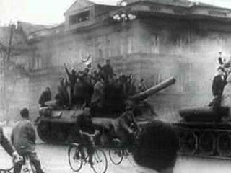
Hungarian Uprising 1956
MAO'S VIEW OF THE 'LESSON FROM EASTERN EUROPE.'
‘The basic problem with some Eastern European countries is that they did not eliminate all those counter-revolutionaries . . . Now they are eating their own bitter fruit . . . Eastern Europe just did not kill on a grand scale. We must kill. And we say it’s good to kill.’

Slide 16
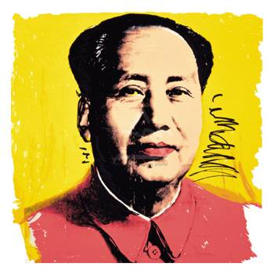
Results of the Hundred Flowers Campaign
1. Mao silenced potential opponents and secured his own position as leader
2. He instilled fear amongst the educated classes who were now less willing to stand against Mao.
3. Mao prepared the ground for introducing the Great Leap reforms – communes, ‘backyard furnaces’ and an extreme form of communist society
4. China’s intelligentsia [brightest minds – artists, writers, journalists, etc] were decimated which set back China’s cultural development.
5. Many students had their education interrupted due to the death of so many teachers - some 5 million children had their schooling terminated
6. Some 4 million people may have lost their lives in the ‘Anti-Rightist campaigns which started after the Hundred Flowers.

Slide 17
700,000 intellectuals were thrown out of their positions and professions
In every factory, 5% of the workers had to be denounced as “rightists”
All were sent to the countryside for reform – many died of malnutrition, illness, cold, overwork, and accidents doing unfamiliar jobs
Some were executed or committed suicide

Slide 18
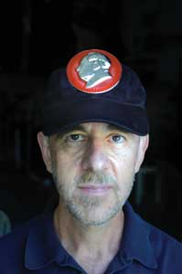
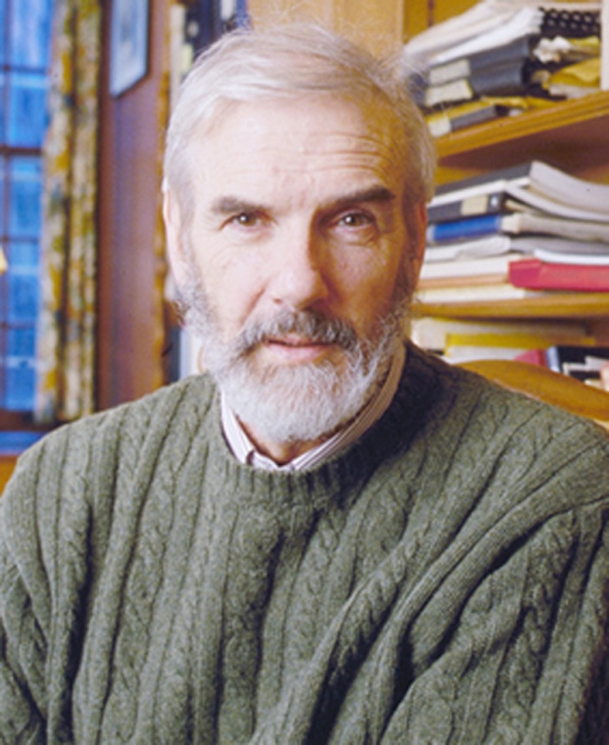
Was the Hundred Flowers Campaign a deliberate trick?
Lee Feigon
Mao genuinely wanted more freedom of expression
Jonathan Spence
Mao didn’t really have a plan – it was all due to confusion
Jung Chang
The speed of reversal shows it was a deliberate trick by Mao to expose critics

Slide 19
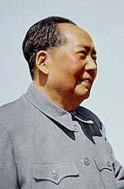
‘Intellectuals are beginning to . . . change their mood from cautious to open . . . One day punishment will come down on their heads . . . We want to let them speak out. You must stiffen your scalps and let them attack! . . . Let all those ox devils and snake demons . . . curse us for a few months. I am casting a long line to bait big fish ’
‘How can we catch the snakes if we don’t let them out of their lairs? We wanted those sons-of-turtles [bastards] to wriggle out and sing and fart . . . That way we can catch them.’
Jung Chang: ‘Mao–the unknown story’, 2005.
P. 435

Slide 20
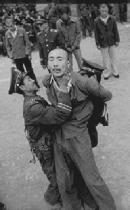
Deportees were just dumped in places like the far north of Manchuria, known as ‘the Great Northern Wilderness’, and had to rig up a shelter ‘in a hurry, using wheat stems to make a roof’ in a temperature of -38C. Even with a fire, ‘it was still a dozen or so degrees below zero . . .’
‘The grass and beaten earth huts we lived in had wind coming in on all sides . . . There were hardly any vegetables or meat . . . We got up . . . Just after 4 at dawn, and did not stop until 7 or 8 in the evening . . . In these 15-16 hours . . . We basically worked non-stop . . . In summer . . . We had to get up at 2.00 am . We had at most three hours’ sleep.
" Tie you a rope, " is a Chinese expression commonly used when someone is arrested by the government.
Jung Chang: ‘Mao – the unknown story’ 2005. P439

Slide 21
Why did the 100 Flowers Campaign occur?

