Slide 1
The Feudal System
- Aaron McCrindle, Will Gardner, Robbie McCann & Sam Myhre

Slide 2
The Feudal System and Society
Feudalism is the name given to a set of legal and military customs in medieval Europe that flourished between the 9th and 15th centuries, which was a system for structuring society around relationships derived from the holding of land in exchange for service or labour.
William I was still the Duke of Normandy when he conquered England. He had to return to Normandy to maintain his control of his land in France. Therefore, he had to leave the country for weeks at a time. He needed a way of controlling England so that the people remained loyal and in order, hence the need for feudalism.
The Domesday Book gives us most of our records of land ownership that represent the system in action.

Slide 3
Origins and Existence
The idea of a 'feudal system' became popular in Britain in the 1960s when the books of the French historian Marc Bloch were published in Britain. In 1789, during the Revolution, feudalism was abolished in France.
The word 'feudal' described laws that were unfair and out of date.
Nowadays historians think the feudal system was a propaganda myth put about by the knights to show themselves as hero-warriors, as peasants were unable to write.
In 1994, the historian Susan Reynolds argued successfully that there was never a feudal 'system' in the Middle Ages.
When poor people began to write in the 14th century, they portrayed themselves as sad, suffering people, who were forced to work to keep the lords in luxury.

Slide 4
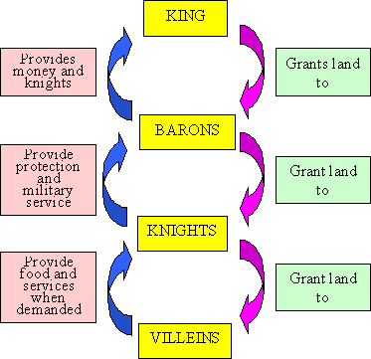
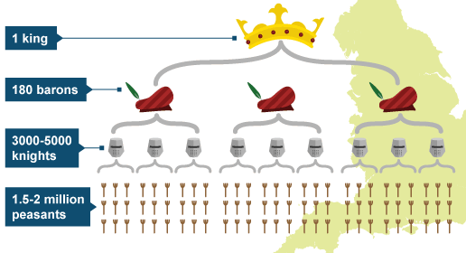

Slide 5
King
In feudalism, the king owns all of the land.
The king granted land to barons/nobles and to knights/vassals.

Slide 6
Barons
They held land directly from the Crown and were granted a legal jurisdiction over their territory, the barony.
They were known as the Lord of the Manor and were in complete control of this land.
They established their own system of justice, minted their own money and set their own taxes.
Barons had to serve on the royal council, pay rent and provide the King with Knights for military service when he demanded it.
The Barons kept as much of their land as they wished for their own use, then divided the rest among their Knights. Barons were very rich.
All noblemen vowed to serve their king. But there were many nobles who grew too powerful and out of their king's control.
One drawback to ­this system was that the­ nobles were very powerful because they controlled the armies. In fact, nobles often warred amongst themselves over territories.­

Slide 7
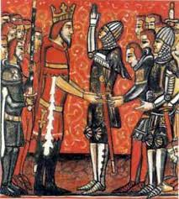
Knights
The king could also grant fiefs to vassals (knights) in exchange for military service (Feudal Levy). Many knights were professional warriors who served in a baron's army. In return, the lord of the manor provided the knight with lodging, food, armour, weapons, horses and money.
Feudalism allowed large territories to be governed in the absence of a central government. Each noble raised an army to defend his fief and to serve the king as needed.
Feudalism did offer a means for a person to advance himself within society through military service and knighthood. Knighthood was not an inherited position; it had to be earned. So, it was an appealing means for a younger son of a lord to advance himself.
The path to knighthood started when a boy was very young. Official training usually began around age 7.­

Slide 8
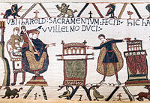
Harold Sacramentum Fecit Willelmo Duci (Harold makes an oath to Duke William) King Harold becomes the vassal of Duke William of Normandy (Bayeux Tapestry)

Slide 9
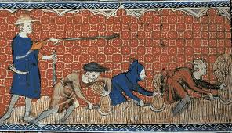
Peasants
During the Middle Ages peasants did not belong to themselves. Everything they owned, their food, homes, and animals all belonged to the lord of the manor.
Known as serfs, peasants were required to work for their lord and in return were allowed to farm their own piece of land.
Many struggled to produce enough food to feed the families, much less fulfill the duties required of them from their lord. The peasants were not free to leave the manor and were required to ask for permission.
To gain freedom a peasant had to save money for his own land or marry a free person.

Slide 10
Was it consistent across the country or did some places have a less structured approach?
The system was generally consistent across the nation, yet William kept a close eye and a tighter grip upon the northern society as it was the most expected to reject the Norman kingship. This made it harder for Anglo-Saxons to ‘climb the ladder’ and gain power in this part of England.
Furthermore, by the 12th century, the stronger barons ruled what could be called little states with their own rules and laws. The finery of their castle-courts were often better than that of their king, and they had permanent armies at their command.

Slide 11
How did it help William gain and maintain control of England?
William confiscated the land in England from the Saxon lords and allocated it to members of his own family and the Norman lords who had helped him conquer the country.
These people were known as tenants-in-chief.
Unlike the older Anglo-Saxon form of feudalism these people did not own the land because the ownership remained with William the Conqueror himself.
The land allocated to a tenants-in-chief was known as a manor and tended to be dispersed across the country rather than being one big area.

Slide 12
The tenant-in-chief had to provide for himself and his family and to support a number of knights. To do this the lord sub-let his land to other lords lower on the social ladder.
The tenants-in-chief did not get the land for free, they rented it from the king in exchange for services. If the services were not provided the tenant-in-chief would be removed, by force if necessary.
This was an important change to the older Anglo-Saxon form of feudalism as it meant William could keep control of his land as bad tenants could be removed.

Slide 13
Anglo-Saxon System
The king alone is the head of society. He is advised by the Witan and his officers.
Beneath the king are the Æthelings, the princes of the blood who are eligible to rule.
The third category is the nobles. They are the influential rulers of the shires who served as councilmen, warriors, and advisors.
After them came the thegns who were the “knights” of the era, although the true idea of a knight had not evolved yet. The thegns owned large portions of land and served the nobles as warriors.
The fifth category is the churls. These are the free wealthy land-owning peasants who were the moneybags of England.
Finally, the villeins were the un-free peasants. Although they were tied to the land, the land could not be taken from them under any circumstances.
England is divided into forty shires. Each shire has its own system of courts and government.
The hundred is a political unit of one hundred hides. A hide is enough land to support a thegn, his horse, and his family. Each hide has a local court and a local official.

Slide 14
How much change or continuity can be seen pre and post 1066?
Considering the potential directions William could have taken in terms of controlling England, little change occurred with the feudal system:
There was still a hierarchal structure with the king at the top and the peasants working the land at the bottom.
Nobles, tenants-in-chief and lords were granted units of land by the king.
Warriors provided military service to the king and nobles in return for money and accommodation.
There were, however, no free or wealthy peasants in Norman feudalism and obviously no powerful Anglo-Saxons dominating the society.

